Slide 1

WELCOME

Slide 2

Crowdfunding—A Creative Integrated IT Solution

Slide 3
Presenters Information
Serial No | Name | ID | Topic
1 | Jobayer Mahmud Parvez | 20-43629-2 | Introduction, Problem background, Research questions.
2 | MD. Mahmudul Hasan | 20-42895-1 | Crowdfunding Advantage to new entrepreneurs.
3 | MD. Zafrul Hasan | 22-46066-1 | Compare between Kickstarter and eBay.
4 | ASHHAB BIN FERDOUS | 20-43275-1 | What characteristics make Kickstarter a social commerce site?
5 | Prithibi Hrick Sarkar | 22-48285-3 | Discuss and Debate

Slide 4

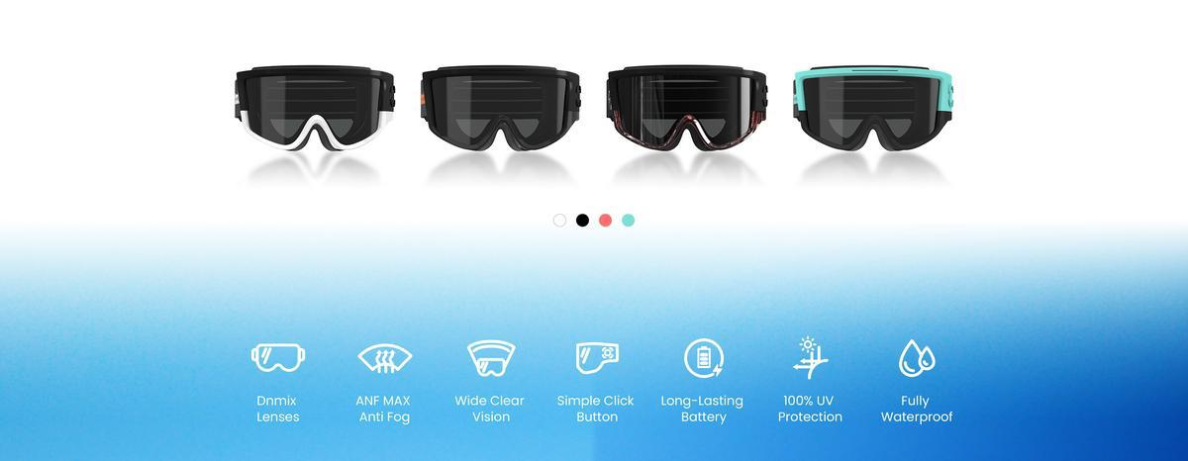

Electrochromic Tint-Changing Snow Goggles
Key Features
Dynamic Tint Adjustment
UV Protection
Anti-Fog and Waterproof
Battery Efficiency
Comfortable Design

Slide 5
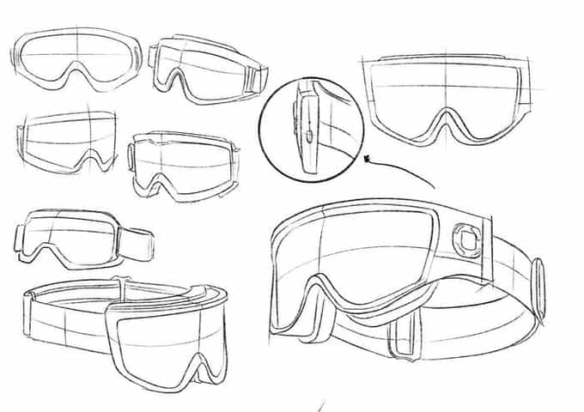
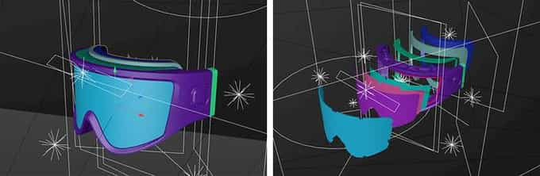
Reward Tiers and Backers
$139 Super Early Bird
$169 Early Bird
Sold-Out Tiers

Slide 6

Crowdfunding and its Advantages to New Entrepreneurs
1
Access Of Funding
Crowdfunding allows you to quickly raise money from a large group of people.
2
Low Risk for Investors
It reduces financial risk by spreading the investment across multiple backers.
3
Marketing & Visibility
Crowdfunding increases your project's visibility and helps attract attention from a wider audience.

Slide 7
Crowdfunding and its Advantages to New Entrepreneurs
4
Community Building
Crowdfunding campaigns can help businesses build a strong community of supporters and customers.
5
Product Validation
Crowdfunding campaigns can help businesses build a strong community of supporters and customers.
6
Rapid Growth
Crowdfunding can provide businesses with the capital they need to grow quickly.

Slide 8
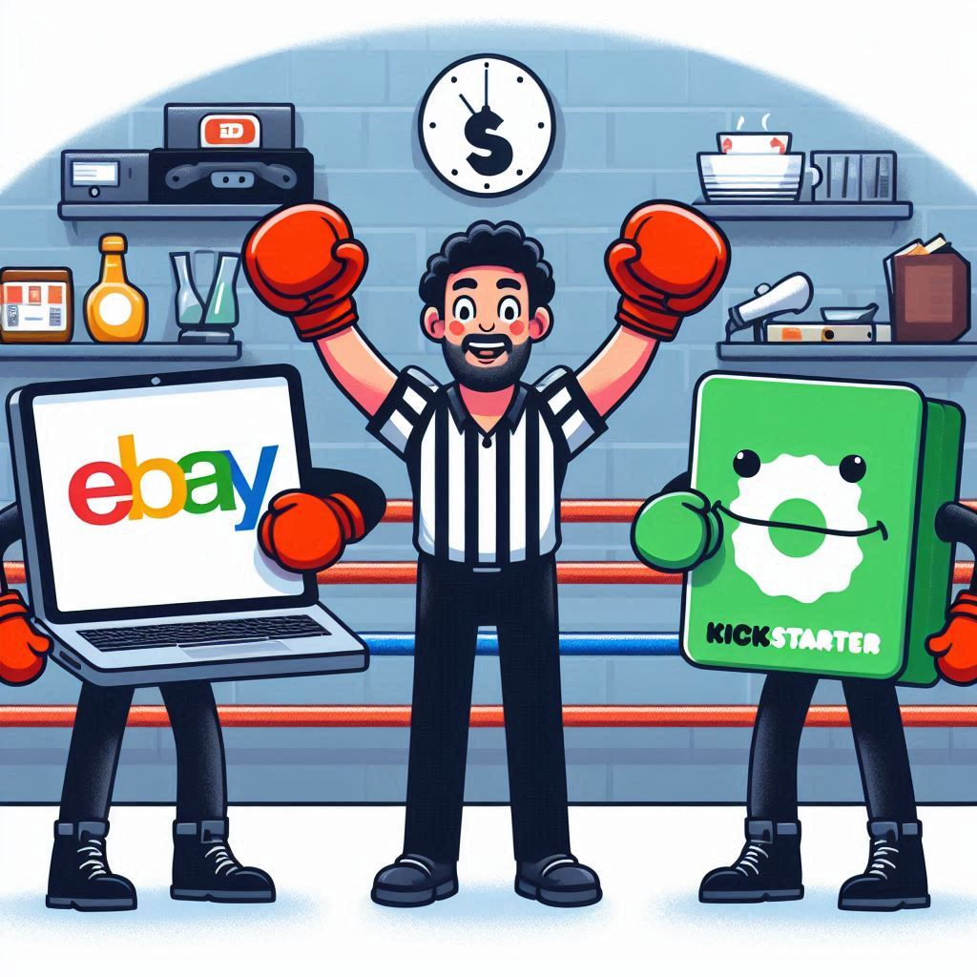
Overview of Kickstarter vs. eBay
Platform Type
1
Funding & Transaction Model
2
Product Availability
3
Interaction Between Users
4

Slide 9
Key Differences in Features & User Experience
Risk & Buyer Motivation
1
Timing & Duration
2
Buyer & Seller Protection
3
Funding Model vs. Direct Purchase
4
Target Audience
5

Slide 10

Kickstarter is a social commerce site because it combines shopping with social interaction. Here are the main reasons:
Community Involvement
Direct Connection
Social Sharing
Collaborative Funding
Story Telling

Slide 11


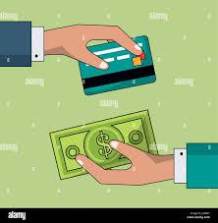
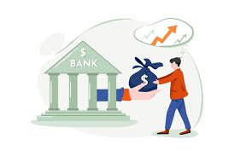
CROWDFUNDING ➡️ FINANCING INDUSTRY
1
Harms To Financing Industries
Bank Loans
Credit Transactions
2
Creation Of A New Industry Itself
Proper use of technology
Social Networking
Mass audience

Slide 12



Opinion
3
Crowdfunding creates opportunities for all.
Less hassle
Financial industries have alternate sources
Scope for Innovation

Slide 13



How Crowdfunding Sites Manage Pledges
GoFundMe:
Indiegogo:
Kickstarter:
Immediate collection
Donation-based
Best for Urgent or flexible funding needs
Flexible or fixed funding
Payment options: Uses Stripe or PayPal for easy transactions.
Best Flexible projects needing partial or full funding.
All-or-nothing model: Funds depend on goal achievement.
Payment processor: Through pay-pal, risk-free for backers.
Best for- Creative projects needing full funding to proceed.

Slide 14



Slide 15
THANK YOU

